Slide 1

CSE 101 - COMPUTER PROGRAMMING I Recursion
Joseph LEDET
Department of Computer Engineering
Akdeniz University
josephledet@akdeniz.edu.tr

Slide 2
Objectives
To describe what a recursive method is and the benefits of using recursion (§18.1).
To develop recursive methods for recursive mathematical functions (§§18.2–18.3).
To explain how recursive method calls are handled in a call stack (§§18.2–18.3).
To solve problems using recursion (§18.4).
To use an overloaded helper method to derive a recursive method (§18.5).
To implement a selection sort using recursion (§18.5.1).
To implement a binary search using recursion (§18.5.2).
To get the directory size using recursion (§18.6).
To solve the Tower of Hanoi problem using recursion (§18.7).
To draw fractals using recursion (§18.8).
To discover the relationship and difference between recursion and iteration (§18.9).
To know tail-recursive methods and why they are desirable (§18.10).

Slide 3
Motivations
Suppose you want to find all the files under a directory that contains a particular word. How do you solve this problem? There are several ways to solve this problem. An intuitive solution is to use recursion by searching the files in the subdirectories recursively.

Slide 4
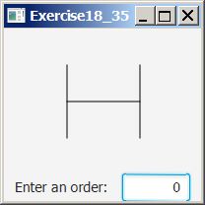
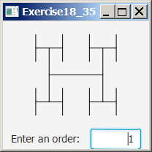
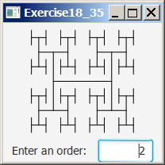
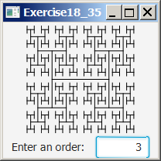
Motivations
H-trees, depicted in Figure 18.1, are used in a very large-scale integration (VLSI) design as a clock distribution network for routing timing signals to all parts of a chip with equal propagation delays.
How do you write a program to display H-trees?
A good approach is to use recursion.

Slide 5
Recursion
Recursion is a basic programming technique you can use in Java, in which a method calls itself to solve some problem. A method that uses this technique is recursive. Many programming problems can be solved only by recursion, and some problems that can be solved by other techniques are better solved by recursion.

Slide 6
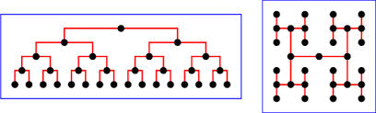
HTree
An HTree is a specialized tree data structure for directory indexing, similar to a B-tree.
They are constant depth of either one or two levels, have a high fanout (maximum number of digital inputs that the output of a single logic gate can feed) factor, use a hash of the filename, and do not require balancing

Slide 7
B-Tree
B-Trees are used to help search various data. Some file systems use B+Tree to search directories, extent descriptors, file allocation and even file retrieval.
First, let's look at a Tree, and we'll use letters to represent files (C, F, L, N, P and Z).
A Tree is a tree structure (upside down as most people say), which consists of one root node, children nodes and leaf nodes. Each node contains a key and pointer.
Linux.org
http://www.linux.org/threads/trees-b-trees-b-trees-and-h-trees.4278/

Slide 8
Computing Factorial
animation
factorial(0) = 1;
factorial(n) = n*factorial(n-1);
factorial(4)
Note: Factorials are very simple things. They're just products, indicated by an (!) exclamation mark. For instance, "four factorial" is written as "4!" and means 1×2×3×4 = 24.
Factorial is the product of an integer and all the integers below it; e.g., factorial four ( 4! ) is equal to 24.

Slide 9
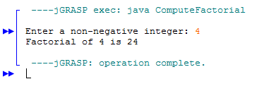
Computing Factorial
factorial(0) = 1;
factorial(n) = n*factorial(n-1);
n! = n * (n-1)!
import java.util.Scanner; public class ComputeFactorial { /** Main method */ public static void main(String[] args) { // Create a Scanner Scanner input = new Scanner(System.in); System.out.print("Enter a non-negative integer: "); int n = input.nextInt(); // Display factorial System.out.println("Factorial of " + n + " is " + factorial(n)); } /** Return the factorial for a specified number */ public static long factorial(int n) { if (n == 0) // Base case return 1; else return n * factorial(n - 1); // Recursive call } }
ComputeFactorial

Slide 10
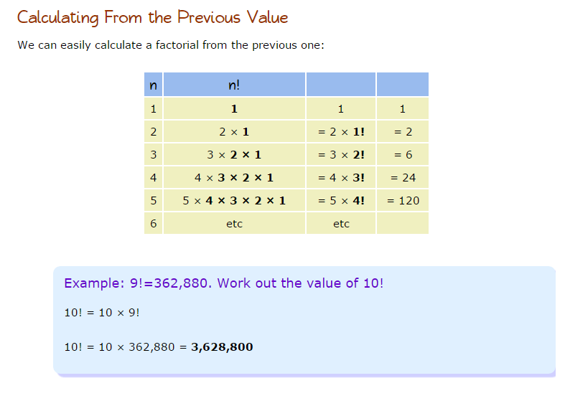
Factorial function (symbol !) means to multiply a series of descending natural numbers. Example: 4! = 4*3*2*1* =24; 7! = 7*6*5*4*3*2*1 = 5040
1! = 1
0! = 1.
n! = n × (n−1)!

Slide 11
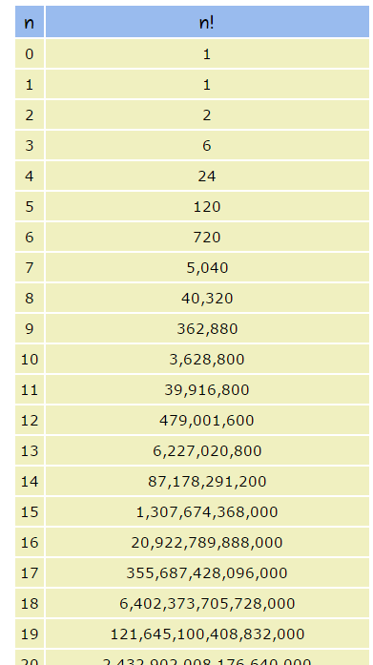
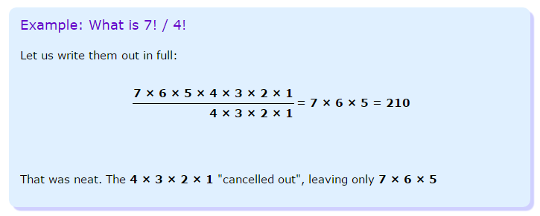

Slide 12
Computing Factorial
animation
factorial(0) = 1;
factorial(n) = n*factorial(n-1);
factorial(4) = 4 * factorial(3)

Slide 13
Computing Factorial
animation
factorial(0) = 1;
factorial(n) = n*factorial(n-1);
factorial(4) = 4 * factorial(3)
= 4 * 3 * factorial(2)

Slide 14
Computing Factorial
animation
factorial(0) = 1;
factorial(n) = n*factorial(n-1);
factorial(4) = 4 * factorial(3)
= 4 * 3 * factorial(2)
= 4 * 3 * (2 * factorial(1))

Slide 15
Computing Factorial
animation
factorial(0) = 1;
factorial(n) = n*factorial(n-1);
factorial(4) = 4 * factorial(3)
= 4 * 3 * factorial(2)
= 4 * 3 * (2 * factorial(1))
= 4 * 3 * ( 2 * (1 * factorial(0)))

Slide 16
Computing Factorial
animation
factorial(0) = 1;
factorial(n) = n*factorial(n-1);
factorial(4) = 4 * factorial(3)
= 4 * 3 * factorial(2)
= 4 * 3 * (2 * factorial(1))
= 4 * 3 * ( 2 * (1 * factorial(0)))
= 4 * 3 * ( 2 * ( 1 * 1)))

Slide 17
Computing Factorial
animation
factorial(0) = 1;
factorial(n) = n*factorial(n-1);
factorial(4) = 4 * factorial(3)
= 4 * 3 * factorial(2)
= 4 * 3 * (2 * factorial(1))
= 4 * 3 * ( 2 * (1 * factorial(0)))
= 4 * 3 * ( 2 * ( 1 * 1)))
= 4 * 3 * ( 2 * 1)

Slide 18
Computing Factorial
animation
factorial(0) = 1;
factorial(n) = n*factorial(n-1);
factorial(4) = 4 * factorial(3)
= 4 * 3 * factorial(2)
= 4 * 3 * (2 * factorial(1))
= 4 * 3 * ( 2 * (1 * factorial(0)))
= 4 * 3 * ( 2 * ( 1 * 1)))
= 4 * 3 * ( 2 * 1)
= 4 * 3 * 2

Slide 19
Computing Factorial
animation
factorial(0) = 1;
factorial(n) = n*factorial(n-1);
factorial(4) = 4 * factorial(3)
= 4 * 3 * factorial(2)
= 4 * 3 * (2 * factorial(1))
= 4 * 3 * ( 2 * (1 * factorial(0)))
= 4 * 3 * ( 2 * ( 1 * 1)))
= 4 * 3 * ( 2 * 1)
= 4 * 3 * 2
= 4 * 6

Slide 20
Computing Factorial
animation
factorial(0) = 1;
factorial(n) = n*factorial(n-1);
factorial(4) = 4 * factorial(3)
= 4 * 3 * factorial(2)
= 4 * 3 * (2 * factorial(1))
= 4 * 3 * ( 2 * (1 * factorial(0)))
= 4 * 3 * ( 2 * ( 1 * 1)))
= 4 * 3 * ( 2 * 1)
= 4 * 3 * 2
= 4 * 6
= 24

Slide 21
Recursion
The idea of recursion is not very common in real world. So, it seems a bit confusing to the novice programmers. Though, I guess, they become used to the concept gradually.
what recursion is about:
a mathematical function...
... that calls itself to compute a value corresponding to an n-th element...
... and which defines some boundaries.
Recursion in computer science is a method where the solution to a problem depends on solutions to smaller instances of the same problem (as opposed to iteration). The approach can be applied to many types of problems, and recursion is one of the central ideas of computer science

Slide 22
Trace Recursive factorial
animation
Executes factorial(4)

Slide 23
Trace Recursive factorial
animation
Executes factorial(3)

Slide 24
Trace Recursive factorial
animation
Executes factorial(2)

Slide 25
Trace Recursive factorial
animation
Executes factorial(1)

Slide 26
Trace Recursive factorial
animation
Executes factorial(0)

Slide 27
Trace Recursive factorial
animation
returns 1

Slide 28
Trace Recursive factorial
animation
returns factorial(0)

Slide 29
Trace Recursive factorial
animation
returns factorial(1)

Slide 30
Trace Recursive factorial
animation
returns factorial(2)

Slide 31
Trace Recursive factorial
animation
returns factorial(3)

Slide 32
Trace Recursive factorial
animation
returns factorial(4)

Slide 33
factorial(4) Stack Trace

Slide 34
Other Examples
f(0) = 0;
f(n) = n + f(n-1);

Slide 35
Fibonacci
Fibonacci is -- Sequence is a series of numbers where a number is found by adding up the two numbers before it. Starting with 0 and 1, the sequence goes 0, 1, 1, 2, 3, 5, 8, 13, 21, 34, and so forth..
The Fibonacci sequence is a set of numbers that starts with a one or a zero, followed by a one, and proceeds based on the rule that each number (called a Fibonacci number) is equal to the sum of the preceding two numbers.

Slide 36
Fibonacci Numbers
Fibonacci series: 0 1 1 2 3 5 8 13 21 34 55 89…
indices: 0 1 2 3 4 5 6 7 8 9 10 11
fib(0) = 0;
fib(1) = 1;
fib(index) = fib(index -1) + fib(index -2); index >=2
fib(3) = fib(2) + fib(1) = (fib(1) + fib(0)) + fib(1) = (1 + 0) +fib(1) = 1 + fib(1) = 1 + 1 = 2
ComputeFibonacci

Slide 37
import java.util.Scanner; public class ComputeFibonacci { /** Main method */ public static void main(String[] args) { // Create a Scanner Scanner input = new Scanner(System.in); System.out.print("Enter an index for a Fibonacci number: "); int index = input.nextInt(); // Find and display the Fibonacci number System.out.println("The Fibonacci number at index " + index + " is " + fib(index)); } /** The method for finding the Fibonacci number */ public static long fib(long index) { if (index == 0) // Base case return 0; else if (index == 1) // Base case return 1; else // Reduction and recursive calls return fib(index - 1) + fib(index - 2); } }

Slide 38
Fibonnaci Numbers, cont.

Slide 39
Think Recursively
Many of the problems presented in the early chapters can be solved using recursion if you think recursively. For example, the palindrome problem can be solved recursively as follows:
public static boolean isPalindrome(String s) {
if (s.length() <= 1) // Base case
return true;
else if (s.charAt(0) != s.charAt(s.length() - 1)) // Base case
return false;
else
return isPalindrome(s.substring(1, s.length() - 1));
}

Slide 40
Recursive Helper Methods
The preceding recursive isPalindrome method is not efficient, because it creates a new string for every recursive call. To avoid creating new strings, use a helper method:
public static boolean isPalindrome(String s) {
return isPalindrome(s, 0, s.length() - 1);
}
public static boolean isPalindrome(String s, int low, int high) {
if (high <= low) // Base case
return true;
else if (s.charAt(low) != s.charAt(high)) // Base case
return false;
else
return isPalindrome(s, low + 1, high - 1);
}

Slide 41
Recursive Selection Sort
Find the smallest number in the list and swaps it with the first number.
Ignore the first number and sort the remaining smaller list recursively.
RecursiveSelectionSort

Slide 42
Recursive Binary Search
Case 1: If the key is less than the middle element, recursively search the key in the first half of the array.
Case 2: If the key is equal to the middle element, the search ends with a match.
Case 3: If the key is greater than the middle element, recursively search the key in the second half of the array.
Linear and Binary Search Video 6:20

Slide 43
public class RecursiveBinarySearch { public static int recursiveBinarySearch(int[] list, int key) { int low = 0; int high = list.length - 1; return recursiveBinarySearch(list, key, low, high); } private static int recursiveBinarySearch(int[] list, int key, int low, int high) { if (low > high) // The list has been exhausted without a match return -low - 1; int mid = (low + high) / 2; if (key < list[mid]) return recursiveBinarySearch(list, key, low, mid - 1); else if (key == list[mid]) return mid; else return recursiveBinarySearch(list, key, mid + 1, high); } }
RecursiveBinarySearch

Slide 44
Directory Size
The preceding examples can easily be solved without using recursion. This section presents a problem that is difficult to solve without using recursion. The problem is to find the size of a directory. The size of a directory is the sum of the sizes of all files in the directory. A directory may contain subdirectories. Suppose a directory contains files , , ..., , and subdirectories , , ..., , as shown below.

Slide 45
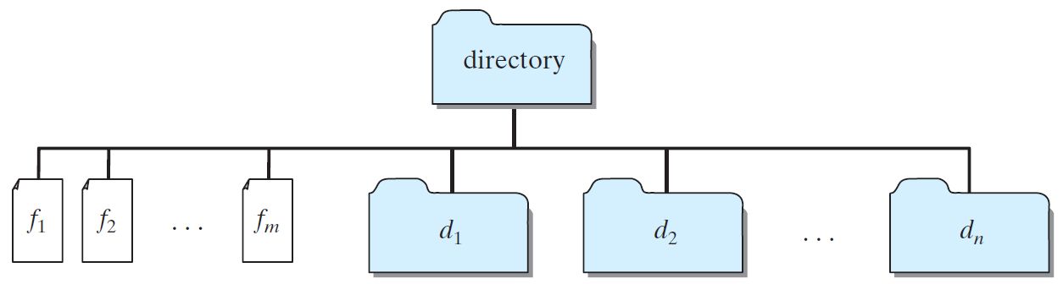
Directory Size
The size of the directory can be defined recursively as follows:
DirectorySize

Slide 46
Tower of Hanoi
There are n disks labeled 1, 2, 3, . . ., n, and three towers labeled A, B, and C.
No disk can be on top of a smaller disk at any time.
All the disks are initially placed on tower A.
Only one disk can be moved at a time, and it must be the top disk on the tower.
https://www.youtube.com/watch?v=34oWQu9RDo0 .31sec
https://www.youtube.com/watch?v=pe3G-xiXIVQ 4:58
https://www.youtube.com/watch?v=q6RicK1FCUs 9:13

Slide 47
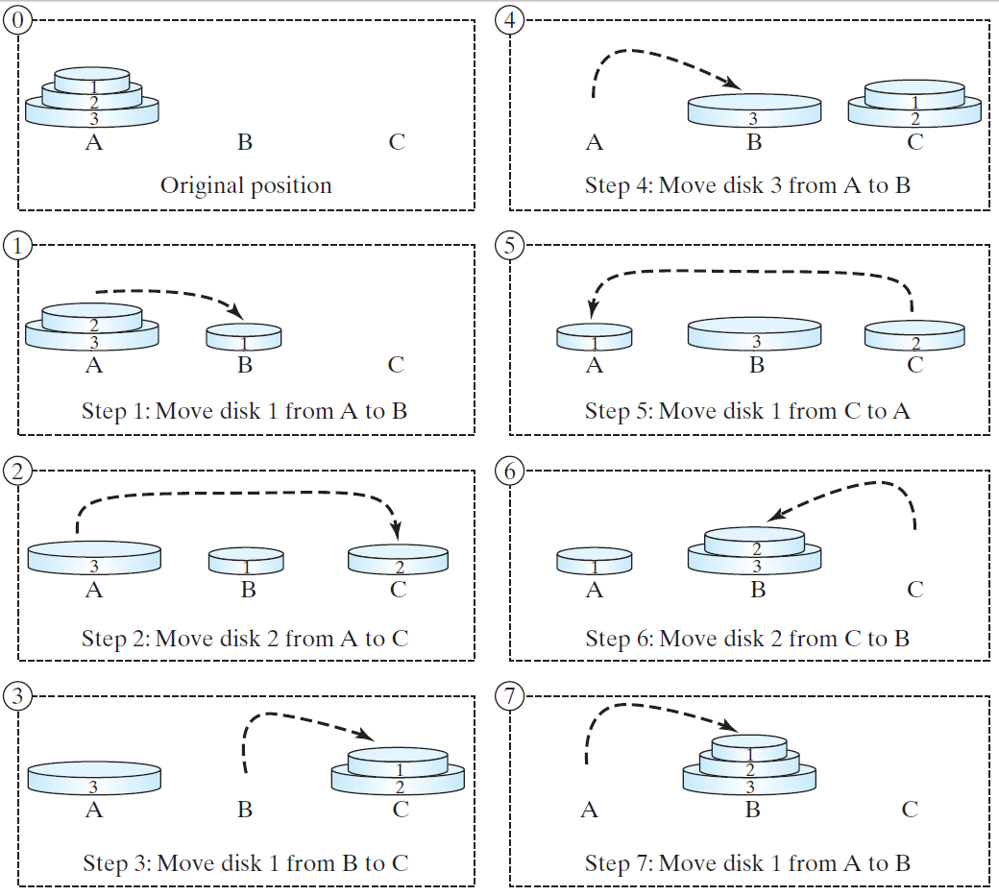
Tower of Hanoi, cont.

Slide 48
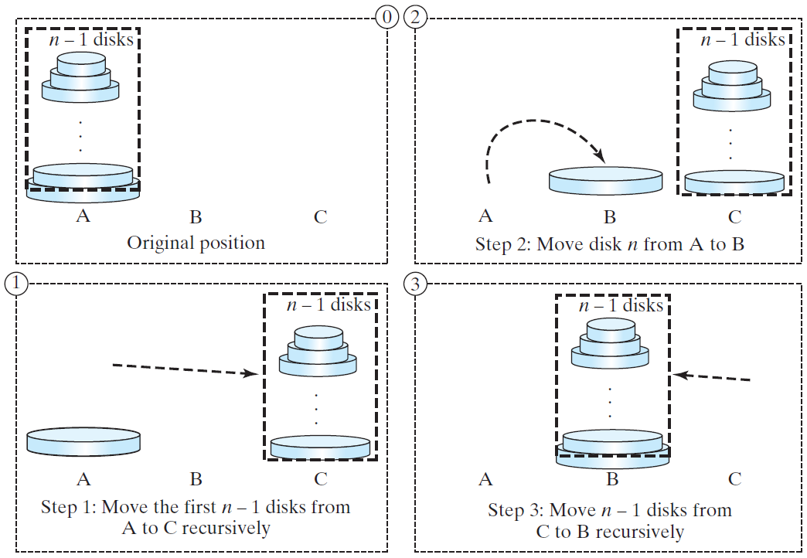
Solution to Tower of Hanoi
The Tower of Hanoi problem can be decomposed into three subproblems.

Slide 49
Solution to Tower of Hanoi
import java.util.Scanner; public class TowerOfHanoi { /** Main method */ public static void main(String[] args) { // Create a Scanner Scanner input = new Scanner(System.in); System.out.print("Enter number of disks: "); int n = input.nextInt(); // Find the solution recursively System.out.println("The moves are:"); moveDisks(n, 'A', 'B', 'C'); } /** The method for finding the solution to move n disks from fromTower to toTower with auxTower */ public static void moveDisks(int n, char fromTower, char toTower, char auxTower) { if (n == 1) // Stopping condition System.out.println("Move disk " + n + " from " + fromTower + " to " + toTower); else { moveDisks(n - 1, fromTower, auxTower, toTower); System.out.println("Move disk " + n + " from " + fromTower + " to " + toTower); moveDisks(n - 1, auxTower, toTower, fromTower); } } }
Move the first n - 1 disks from A to C with the assistance of tower B.
Move disk n from A to B.
Move n - 1 disks from C to B with the assistance of tower A.
TowerOfHanoi

Slide 50
Towers Legend
Legend has it that a group of Eastern monks are the keepers of three towers on which sit 64 golden rings. Originally all 64 rings were stacked on one tower with each ring smaller than the one beneath. The monks are to move the rings from this first tower to the third tower one at a time but never moving a larger ring on top of a smaller one. Once the 64 rings have all been moved, the world will come to an end.

Slide 51
Exercise 18.3 GCD
gcd(2, 3) = 1
gcd(2, 10) = 2
gcd(25, 35) = 5
gcd(205, 301) = 5
gcd(m, n)
Approach 1: Brute-force, start from min(n, m) down to 1, to check if a number is common divisor for both m and n, if so, it is the greatest common divisor.
Approach 2: Euclid’s algorithm
Approach 3: Recursive method

Slide 52
Approach 2: Euclid’s algorithm
// Get absolute value of m and n;
t1 = Math.abs(m); t2 = Math.abs(n);
// r is the remainder of t1 divided by t2;
r = t1 % t2;
while (r != 0) {
t1 = t2;
t2 = r;
r = t1 % t2;
}
// When r is 0, t2 is the greatest common
// divisor between t1 and t2
return t2;

Slide 53
Fractals?
A fractal is a geometrical figure just like triangles, circles, and rectangles, but fractals can be divided into parts, each of which is a reduced-size copy of the whole. There are many interesting examples of fractals. This section introduces a simple fractal, called Sierpinski triangle, named after a famous Polish mathematician.

Slide 54
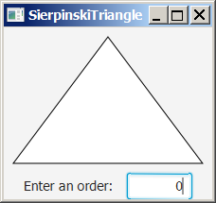
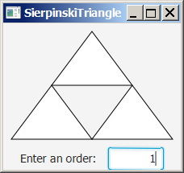
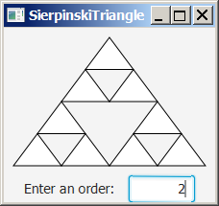
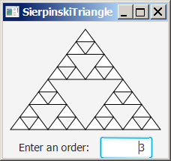
Sierpinski Triangle
It begins with an equilateral triangle, which is considered to be the Sierpinski fractal of order (or level) 0, as shown in Figure (a).
Connect the midpoints of the sides of the triangle of order 0 to create a Sierpinski triangle of order 1, as shown in Figure (b).
Leave the center triangle intact. Connect the midpoints of the sides of the three other triangles to create a Sierpinski of order 2, as shown in Figure (c).
You can repeat the same process recursively to create a Sierpinski triangle of order 3, 4, ..., and so on, as shown in Figure (d).

Slide 55
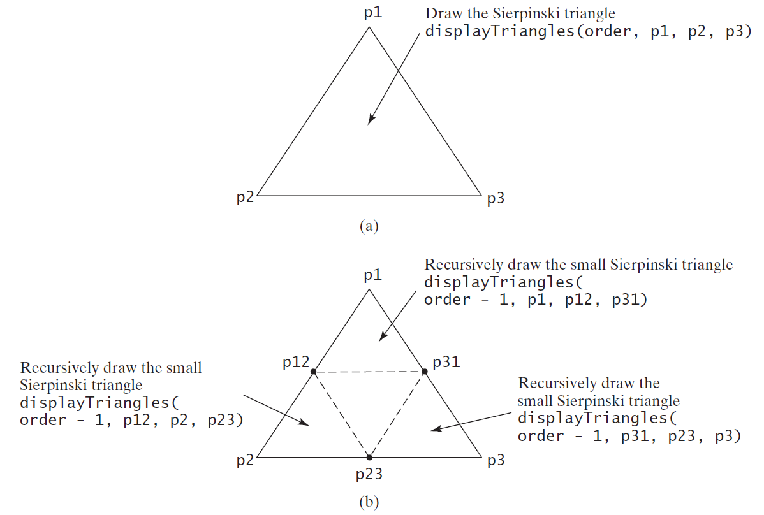
Sierpinski Triangle Solution
SierpinskiTriangle

Slide 56
Recursion vs. Iteration
Recursion is an alternative form of program control. It is essentially repetition without a loop.
Recursion bears substantial overhead. Each time the program calls a method, the system must assign space for all of the method’s local variables and parameters. This can consume considerable memory and requires extra time to manage the additional space.

Slide 57
Advantages of Using Recursion
Recursion is good for solving the problems that are inherently recursive.

Slide 58
Tail Recursion
A recursive method is said to be tail recursive if there are no pending operations to be performed on return from a recursive call.
Non-tail recursive
ComputeFactorial
Tail recursive
ComputeFactorialTailRecursion

